Slide 1
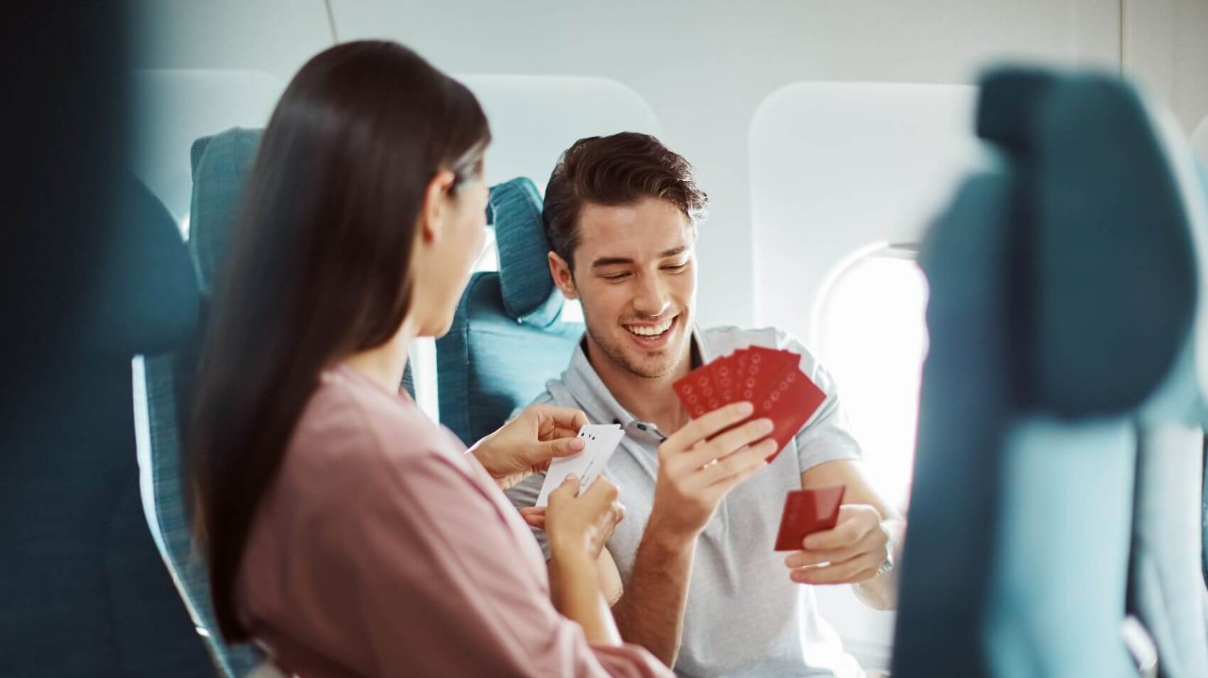
CX Match
Meet the Best

Slide 3
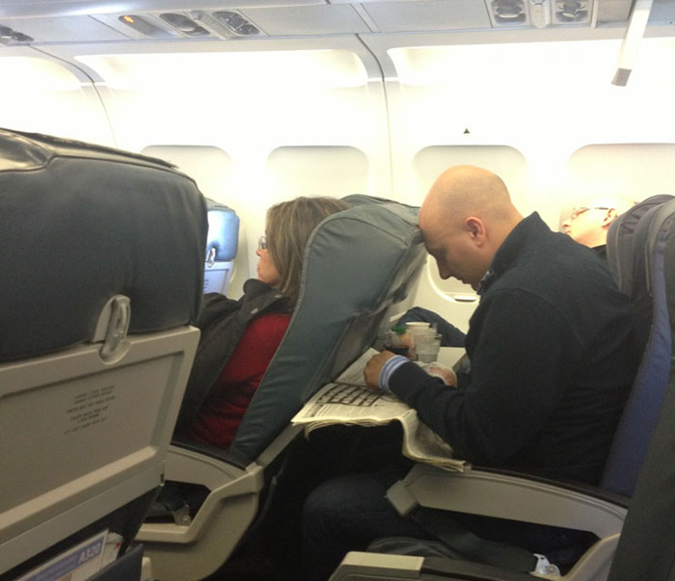

Slide 4
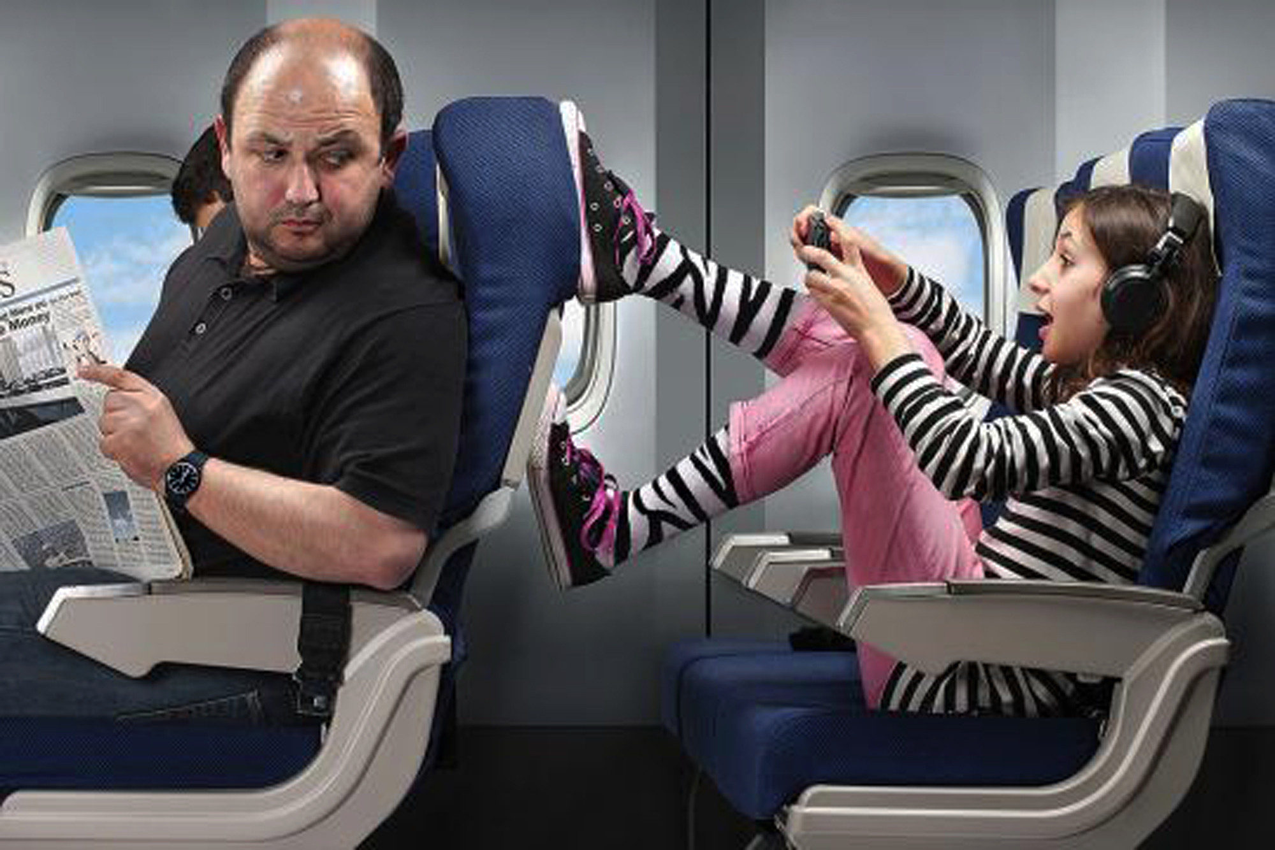

Slide 5

London City Airport survey shows
63% of passengers felt irritated by passengers reclining their seats far back
43% of passengers dislike travellers talking loudly on a flight
Notes:
London City Airport survey 63 % of passengers felt irritated if the fellow passengers recline their seats far back, 43% of passengers dislike other travellers talking loud on plane.
HSBC survey 16 percent of travelers had formed a business connection on a flight, while 14 percent made long-lasting friendships with folks they met while flying
This shows us the importance of having suitable neighbors in flight

Slide 6

London City Airport survey shows
63% of passengers felt irritated by passengers reclining their seats far back
43% of passengers dislike travellers talking loudly on a flight
HSBC survey points out
16% of travelers had formed a business connection on a flight
14% made long-lasting friendships with other passengers
Notes:
London City Airport survey 63 % of passengers felt irritated if the fellow passengers recline their seats far back, 43% of passengers dislike other travellers talking loud on plane.
HSBC survey 16 percent of travelers had formed a business connection on a flight, while 14 percent made long-lasting friendships with folks they met while flying
This shows us the importance of having suitable neighbors in flight

Slide 7
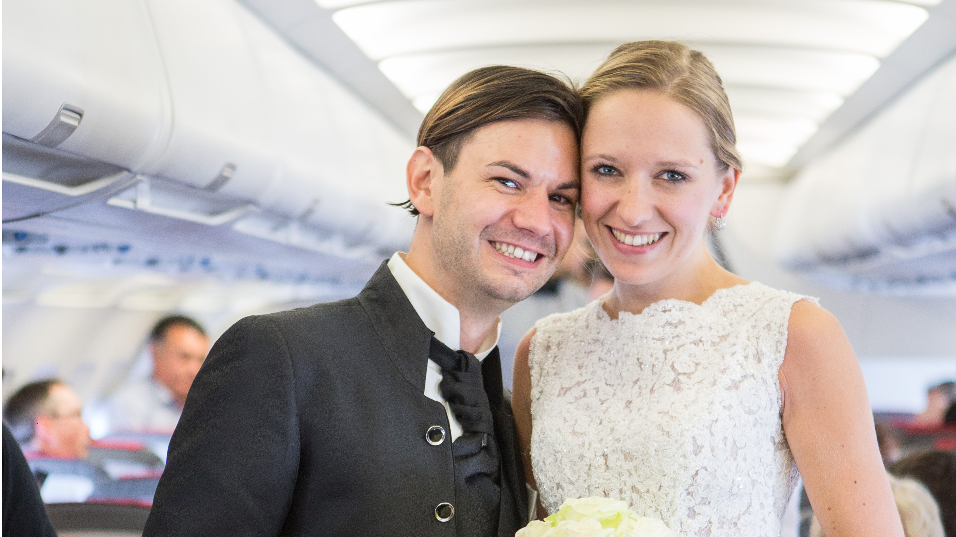
Impact on Customer Experience
HSBC survey shows
1 out of 50 people find love on flight

Slide 8
Impact on Customer Experience
Seatmates Matter!
HSBC survey shows
1 out of 50 people find love on flight

Slide 9
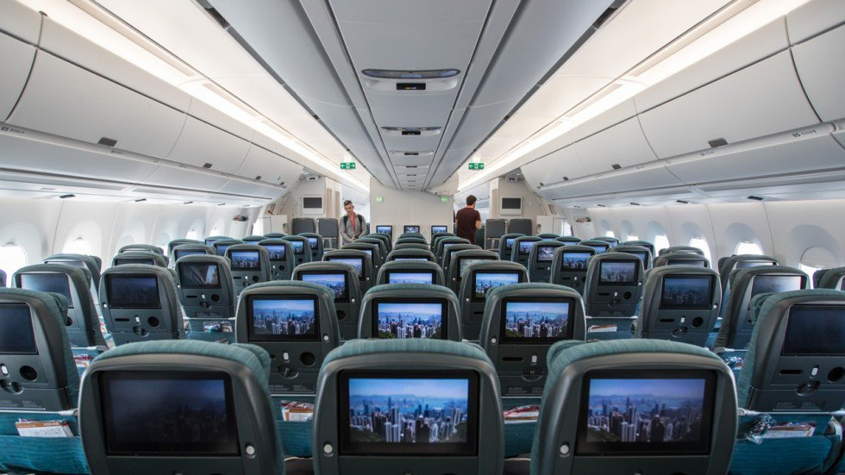
CX Match “Personalizes Your Seatmates” by Machine Learning
Fill in survey while booking
Seat matching
On flight service differentiation
Feedback on arrival

Slide 10
Impact on Customer Experience
Minimize Disturbance + Maximize Relationship

Slide 11
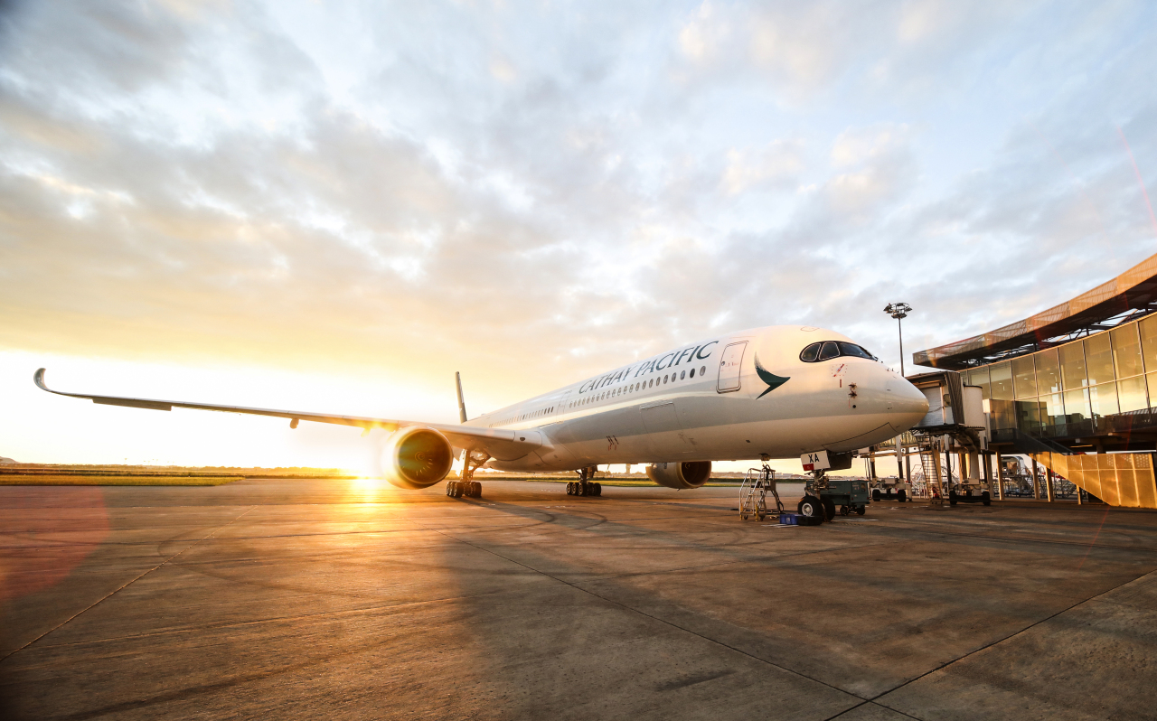

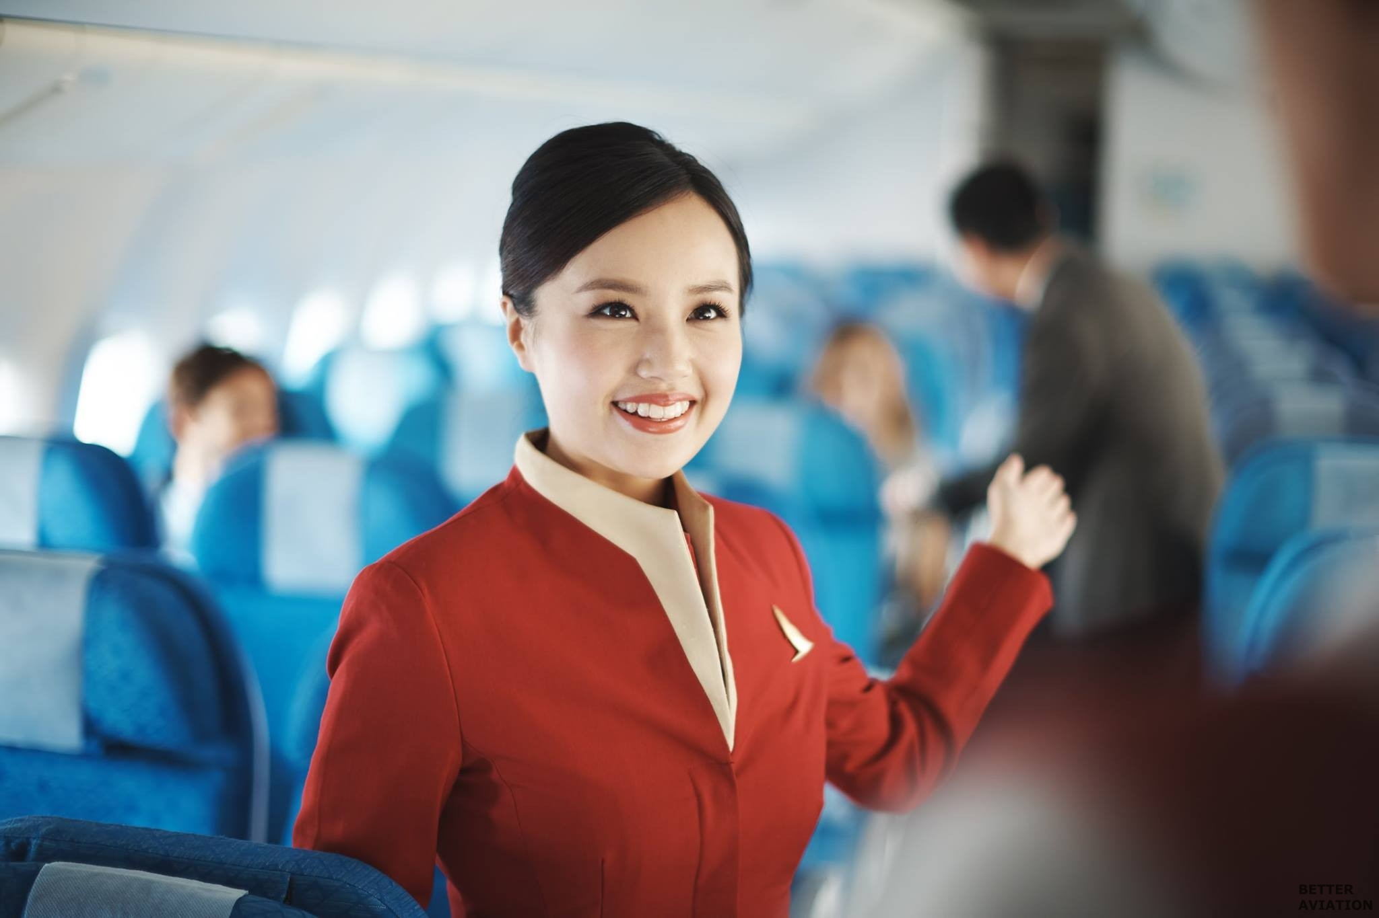

Impact on Cathay Pacific
Starting Point of Personalization
Service Improvement
Potential Ancillary Revenue

Slide 12
CX Match
Meet the Best

Slide 13
USTPower Thanks for listening!!!

Slide 14
Appendix – Technical Details
For each pair of passengers, calculate their “suitability” to be seatmates according to their personal preferences.
Find the maximum weighted matching among all the passengers, so that the total “suitability” will be maximized.
After each flight, base on the feedback provided by each passenger, collect data for that passenger and use machine learning to improve the “suitability estimating function”.

Slide 15
Appendix – Case Study
KLM Meet & Seat
Facebook / Linkedin
Focus only on networking

Slide 16
Appendix – Current Seating Arrangement
Travel agency
Marco Polo / Pay for early selection
48 hours – First Come First Serve
Airport

